Slide 1
Selecting the Best location for developing residential complex for senior citizens in Kolkata
By – Subhodip Giri
Date – 1st May 2020

Slide 2
Introduction: Business Problem
In this project we will try to find an optimal location for building a residential complex exclusively for senior citizens in Kolkata. Specifically, this report will be targeted to a Real Estate company interested in developing a property in Kolkata, West Bengal, India.
We will try to find out such location which are in vicinity of a hospital. We are also particularly interested in areas with maximum number of facilities in vicinity of ra. We would also prefer locations as close to city center as possible, if first two conditions are met.
We will use our data science powers to generate a few most promising neighborhoods based on these criteria. Advantages of each area will then be clearly expressed so that best possible final location can be chosen by stakeholders.

Slide 3
Data
Based on definition of our problem, factors that will influence our decision are:
number of and distance to nearby venues in the neighborhood, if any
distance of location from city center
Following data sources will be needed to extract/generate the required information:
centers of hospitals will be generated algorithmically, and approximate location of hospitals will be obtained using Foursquare API
number of nearby venues and their type and location in every neighborhood will be obtained using Foursquare API
coordinates of Kolkata will be obtained using Foursquare API

Slide 4
Methodology
In this project we will direct our efforts on detecting areas of hospitals in Kolkata that have most number of distinct amenities/facilities in its vicinity. We will limit our analysis to area ~5km around city center.
In first step we will collect the required data: location of hospitals within 5km from Kolkata center (according to Foursquare categorization).
Second step in our analysis will be exploration of 'nearby venues' across different hospitals of Kolkata - we will use Foursquare to find the areas close to the hospitals
In third and final step we will create clusters of locations of hospitals. We will take into consideration locations of hospitals with most number of nearby venues in radius of 500 meters. We will present map of all such locations and create clusters (using k-means clustering) of those locations to identify the most favorable location for a residential complex for senior citizen near any hospital. As a result, it should be a starting point for final 'street level' exploration and search for optimal venue location by stakeholders.

Slide 5
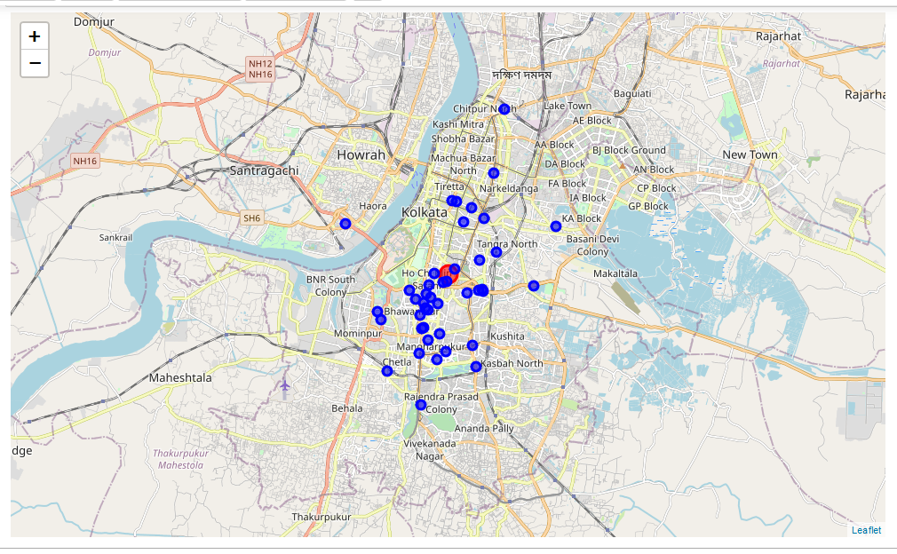
Map showing locations of various hospitals within 5 km of Kolkata city center

Slide 6
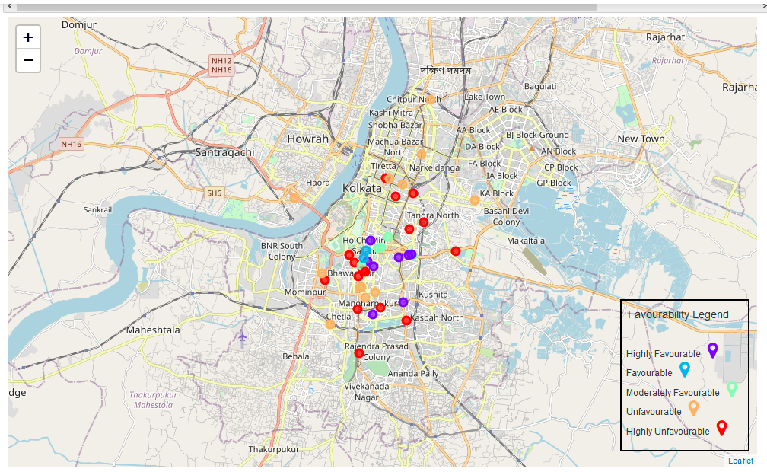
Map showing locations on basis of their favorability for constructing a residential complex

Slide 7
Results and Discussion
From our above analysis, we found that most of the hospitals are situated nearer to the city center. We also found that most of the favorable locations are also situated nearer to the city center. These locations have 10 to 20 different kinds of venues in the radius of 500m.
we can also see that highly favorable and highly unfavorable locations are situated next to each other. This is an anomaly There are various reasons for it. Either the hospital is not so popular, or the hospital is situated on the border of a military facility where residential construction is not allowed. The hospital is nearer to a railway station and the hospital belongs to railways and no outsider residential construction is allowed on railway property. The hospital might be a military hospital where only army or their families are allowed.
We can also see that all the hospitals farther from city center are unfavorable for property development as they lack good number of venues in their vicinity.

Slide 8
Conclusion
Purpose of this project was to identify areas of Hospitals in Kolkata having maximum number of distinct nearby venues in order to aid stakeholders in narrowing down the search for optimal location for a new residential complex for senior citizens. By calculating number of nearby distict vicinity we have created a map showing the locations starting from most to least favorable for building the residential complex. These locations will provide a good idea to the stakeholders to choose the starting points for final exploration.
Final decision on optimal location will be made by stakeholders based on specific characteristics of neighborhoods and locations in every recommended hospital zone, taking into consideration additional factors like proximity to major roads, real estate prices, social and economic dynamics of every neighborhood, crime record of that particular location etc.

